Slide 1
The Tower Philosophy
Welcome

Slide 2
Rule Change Topics
The coaching box size has doubled
We are to report fouls with two hands
Jersey naming restrictions
New warning for coaches misconduct

Slide 3
2017-18 NFHS BASKETBALL RULES POWER POINT
Welcome!
Notes:
WELCOME TO THE NFHS BASKETBALL RULES POWER POINT!

Slide 4
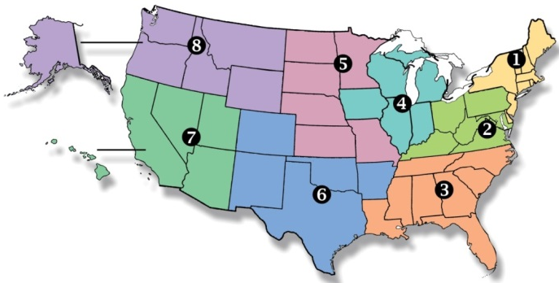
National Federation of State High School Associations
Membership = 50 member state associations and D.C.
NFHS reaches more than 19,000 high schools and 12 million participants in high school activity programs, including more than 7.8 million in high school sports.
Notes:
National Federation of State High School Associations
Membership = 50 member state associations and D.C.
NFHS reaches more than 19,000 high schools and 12 million participants in high school activity programs, including more than 7.8 million in high school sports.

Slide 5
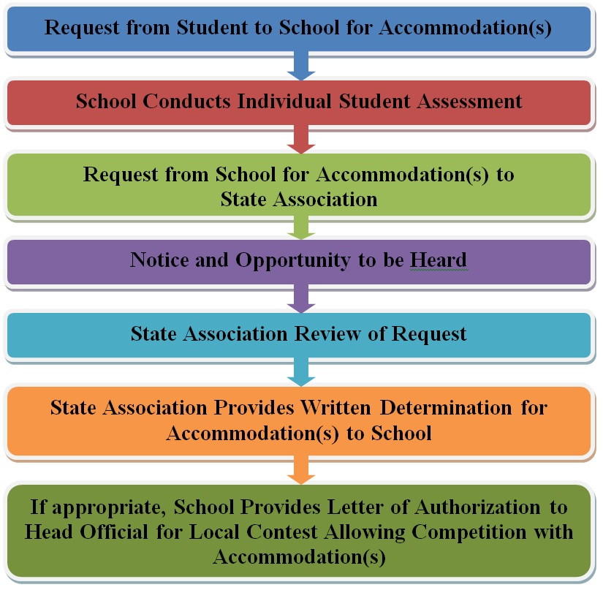
Guidelines for Schools and state associations for consideration of accommodations
Notes:
To assist state associations in working with schools for the inclusion of students with disabilities the following guide prepared by the NFHS Task Force on the Inclusion of Students with Disabilities is being provided for your review.
Following these guidelines will assist in the individual student assessment by the student and the school.
When requesting a possible accommodation, coaches should work with their school and the state association as early as possible in the sport season.
Contest officials shall defer decisions on rule accommodations to the respective state association.
This information serves as a guide. Each state association may develop its own process.

Slide 6
RULES INTERPRETATION EDITORIAL CHANGES POINTS OF EMPHASIS
2017-18
Notes:
2017-18
RULES INTERPRETATION EDITORIAL CHANGES POINTS OF EMPHASIS

Slide 7
Rules changes
2017-18
Notes:
2017-18
RULES CHANGES

Slide 8
Rule 1-13-2 coaching box
The coaching box shall be outlined outside the side of the court on which the scorer's and timer's table and team benches are located. The area shall be bounded by a line drawn 28 feet from the end line towards the Division line. At this point two lines drawn at each end of the box from the sideline toward the team bench become the ends of the coaching box.
Note: State Associations may alter the length and placement of the 28 foot (maximum) coaching box. It may not be longer than 28 feet nor extended beyond the end line of the court.
Effective Immediately. Tape may be used to extend the 14-foot line to 28 feet.
Notes:
Rule 1-13-2
The coaching box shall be outlined outside the side of the court on which the scorer's and timer's table and team benches are located. The area shall be bounded by a line drawn 28 feet from the end line towards the Division line. At this point a line drawn from the sideline toward the team bench becomes the end of the coaching box going towards the end line.
Note: State Associations may alter the length and placement of the 28 foot (maximum) coaching box.
Effective Immediately. Tape may be used to extend the 14-foot line to 28 feet

Slide 9
RULE 1-13-2 TEAM BENCH LOCATIONS, COACHING BOX, TIME-OUT AREA
State associations have the ability to alter the location and length of the coaching box. The maximum length of the coaching box cannot exceed 28 feet. In MechaniGram A, the traditional end line to 28-foot mark coaching box is used and legal. In MechaniGram B, the 14-foot coaching box is placed from 28-foot mark and back toward the end line (as done in recent years) and is legal. In MechaniGram C, the 14-foot coaching box is relocated to be centered around the 28-foot mark and would be illegal (the 28-foot mark is furthest to the table).
Notes:
Rule 1-13-2 Team Bench Location
State associations have the ability to alter the location and length of the coaching box. The maximum length of the coaching box cannot exceed 28 feet. In MechaniGram A, the traditional end line to 28-foot mark coaching box is used and legal. In MechaniGram B, the 14-foot coaching box is placed from 28-foot mark and back toward the end line (as done in recent years) and is legal. In MechaniGram C, the 14-foot coaching box is relocated to be centered around the 28-foot mark and would be illegal (the 28-foot mark is furthest to the table).

Slide 10
Rule 2-9-1 signal to the scorer
When a foul occurs, an official shall signal the timer to stop the clock. The official shall verbally inform the offender, then with finger(s) of two hands, indicate to the scorer the number of the offender and the number of free throws.
Rationale: To minimize foul reporting errors, that occur between the officials and the scorekeepers when the information gets lost in the translation. Two handed reporting is easier for the scorekeepers to see and comprehend in addition to being less confusing.
Notes:
Rule 2-9-1:
When a foul occurs, an official shall signal the timer to stop the clock. The official shall verbally inform the offender, then with finger(s) of two hands, indicate to the scorer the number of the offender and the number of free throws.
Rationale: To minimize foul reporting errors, that occur between the officials and the scorekeepers when the information gets lost in the translation. Two handed reporting is easier for the scorekeepers to see and comprehend in addition to being less confusing.

Slide 11
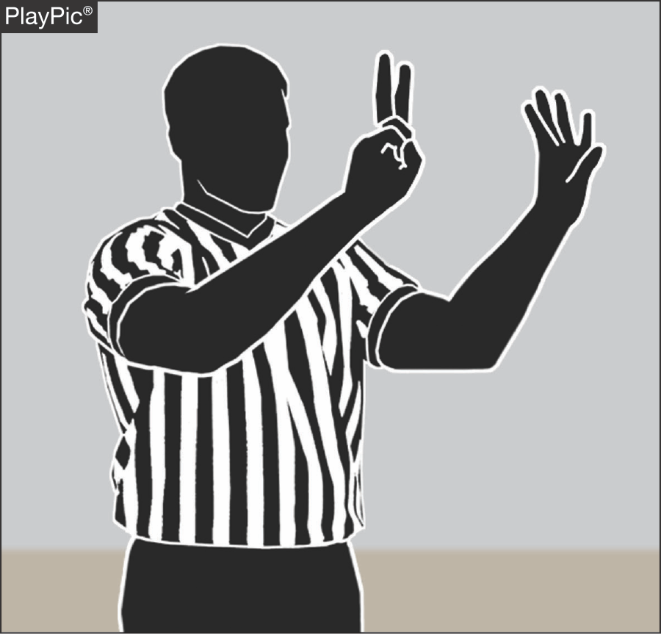
RULE 2-9-1 SIGNALS (TWO-HAND REPORTING)
Officials should report fouls to the scorer by using two hands.
The right hand will indicate the first digit (tens or “two” in the PlayPic example) and the left hand will show a second digit (ones or “four”), so it appears in a left-to-right sequence to the scorer.
When reporting, the official should verbalize 24, not two-four.
Notes:
RULE 2-9-1 SIGNALS
Officials should report fouls to the scorer by using two hands to display the fouler’s number. The official’s right hand will indicate the first digit (tens or “two” in the PlayPic example) and the left hand will show a second digit (ones or “four”), so it appears in a left-to-right sequence to the scorer. When reporting, the official should verbalize 24, not two-four.

Slide 12
Rule 3-4-1d TEAM JERSEY
There are no color/design restrictions in the area of the team jersey from the imaginary line at the base of the neckline to the top of the shoulder and in the corresponding area on the back of the jersey. There are restrictions on what identifying names may be placed in this area (see Article 3-4-4).
Rationale: Provide guidance on the forthcoming restrictions for this area of the jersey.
Notes:
Rule 3-4-1D
There are no color/design restrictions in the area of the team jersey from the imaginary line at the base of the neckline to the top of the shoulder and in the corresponding area on the back of the jersey. There are restrictions on what identifying names may be placed in this area (see Article 3-4-4).
Rationale: Provide guidance on the forthcoming restrictions for this area of the jersey.

Slide 13
Rules 3-4-4 UNIFORMS
Identifying name(s) shall adhere to the following:
a. If used, lettering with school name, school’s nickname, school logo, player’s name and /or abbreviation of the official school name shall be placed horizontally on the jersey.
b. The panel in the shoulder area of the jersey on the back may be used for placing an identifying name as well.
Rationale: Provide guidance to persons purchasing uniforms in determining what wording should go onto the jersey.
Notes:
Rules 3-4-4 Uniforms
Identifying name(s) shall adhere to the following:
a. If used, lettering with school name, school’s nickname, school logo, player’s name and /or abbreviation of the official school name shall be placed horizontally on the jersey.
b. The panel in the shoulder area of the jersey on the back may be used for placing an identifying name as well.
Rationale: Provide guidance to persons purchasing uniforms in determining what wording should go onto the jersey.

Slide 14
RULE 3-4-4a UNIFORMS
If used, lettering is permitted in the form of a school’s name, a school’s nickname, a player’s name or an abbreviation of the school’s official name. PlayPics A, B and C are all legal examples.
Notes:
Rule 3-4-4a Uniforms
If used, lettering is permitted in the form of a school’s name, a school’s nickname, a player’s name or an abbreviation of the school’s name. PlayPics A, B and C are all legal examples.

Slide 15
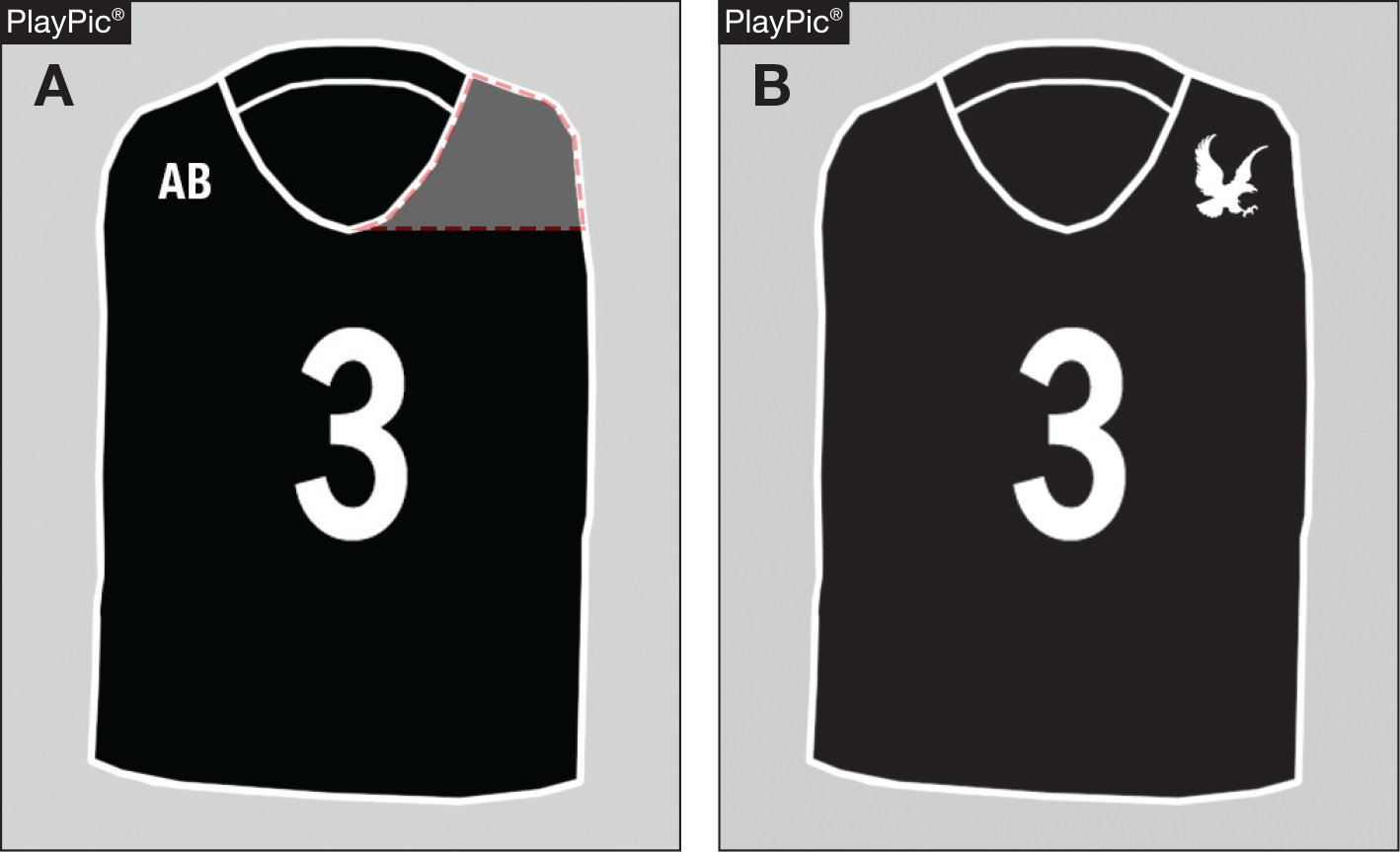
RULE 3-4-4b UNIFORMS
In PlayPic A, the shoulder area is identified and a similar
area on the back is a
legal area for the allowable identifying
name.
The initials of a player are shown which is an illegal example. The names are generally placed above the number or in the upper shoulder area on the back of the jersey.
In PlayPic B, a school logo would be allowed.
Notes:
Rule 3-4-4b Uniforms
In PlayPic A, the shoulder area is identified and a similar area on the back is a legal area for the allowable identifying name.
The initials of a player are shown which is an illegal example. The names are generally placed above the number or in the upper shoulder area on the back of the jersey.
In PlayPic B, a school logo would be allowed.

Slide 16
RULE 4-48 NEW behavioral warning
Warning for Coach/Team Conduct
A warning to a coach/team for misconduct is an administrative procedure by an official, which is recorded in the scorebook by the scorer and reported to the Head Coach:
Art. 1 . . . For conduct, such as that described in rule 10-5-1a,b,d,e,f; 10-5-2; 10-5-4 the official shall warn the head coach unless the offense is judged to be major, in which case a technical foul shall be assessed. Note: A warning is not required prior to calling a technical foul.
Notes:
Rule 4-48 New Behavioral Warning
Warning for Coach/Team Conduct
A warning to a coach/team for misconduct is an administrative procedure by an official, which is recorded in the scorebook by the scorer and reported to the Head Coach:
Art. 1 . . . For conduct, such as that described in rule 10-5-1a,b,d,e,f; 10-5-2; 10-5-4 the official shall warn the head coach unless the offense is judged to be major, in which case a technical foul shall be assessed. Note: A warning is not required prior to calling a technical foul.

Slide 17
RULE 4-48 NEW behavioral warning
Art. 2 . . . For the first violation of rule 10-6-1, the official shall warn the head coach unless the offense is judged to be major, in which case a technical foul shall be assessed. Note: A warning is not required prior to calling a technical foul.
Rationale: Stopping play and making sure that the bench and the coach know that an official warning has been given, sends a clear message to everyone in the gym and impacts the behavior of the coach, and in some cases the behavior of the opposing coach. This change in behavior creates a better atmosphere and many times avoids the need to administer a technical foul.
Notes:
Rule 4-48 New Behavioral Warning
Art. 2 . . . For the first violation of rule 10-6-1, the official shall warn the head coach unless the offense is judged to be major, in which case a technical foul shall be assessed. Note: A warning is not required prior to calling a technical foul.
Rationale: Stopping play and making sure that the bench and the coach know that an official warning has been given, sends a clear message to everyone in the gym and impacts the behavior of the coach, and in some cases the behavior of the opposing coach. This change in behavior creates a better atmosphere and many times avoids the need to administer a technical foul.

Slide 18
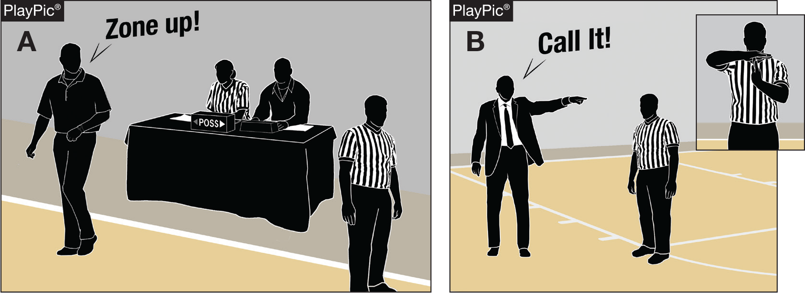
RULE 4-48-1a NEW BEHAVIORAL WARNING
In PlayPic A, the official shall stop the game and begin the administrative process to have the warning recorded by the scorer in the scorebook and then notify the head coach.
In PlayPic B, when the behavior is major no warning should be issued and the officials should rule a technical foul.
Notes:
RULE 4-48-1a NEW BEHAVIORAL WARNING
In PlayPic A, the official shall stop the game and begin the administrative process to have the warning recorded by the scorer in the scorebook and then notify the head coach.
In PlayPic B, when the behavior is major no warning should be issued and the officials should rule a technical foul.

Slide 19
Editorial changes
2017-18
Notes:
EDITORIAL CHANGES

Slide 20
RULE 4-4-7b BALL LOCATION, AT DISPOSAL
A ball is at the disposal of the thrower or free thrower after it is bounced to him/her.
Rationale: Clarifies what player has the ball at his/her disposal.
Notes:
RULE 4-4-7b BALL LOCATION, AT DISPOSAL
A ball is at the disposal of the thrower or free thrower after it is bounced to him/her.

Slide 21
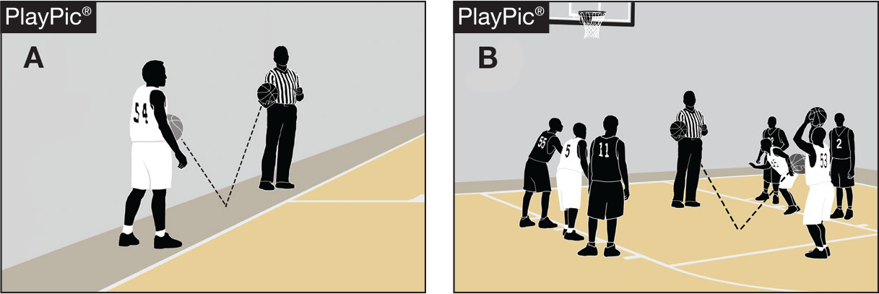
RULE 4-4-7b BALL LOCATION, AT DISPOSAL
In PlayPic A, the ball is at the thrower’s disposal when the thrower catches the ball from the official’s bounce. In PlayPic B, the ball is at the free-thrower’s disposal when the free thrower catches the ball from the official’s bounce.
Notes:
RULE 4-4-7b BALL LOCATION, AT DISPOSAL
In PlayPic A, the ball is at the thrower’s disposal when the thrower catches the ball from the official’s bounce. In PlayPic B, the ball is at the free-thrower’s disposal when the free thrower catches the ball from the official’s bounce.

Slide 22
Points of emphasis
2017-18
Notes:
2017-18
Points of emphasis

Slide 23
Points of Emphasis
Head covering worn for medical or religious reason
Team control on throw-in
Intentional fouls
Guarding

Slide 24
Equipment worn on head for medical or religious reason
Specific procedures have been established for allowing a head covering to be worn for medical or religious reasons. A player who is required to wear a head covering for medical or religious reasons must provide a physician statement or appropriate documented evidence to the state association for approval. If approved, the state association shall provide written authorization to the school to be made available to officials.
Notes:
Equipment worn on head for medical or religious reason.
Specific procedures have been established for allowing a head covering to be worn for medical or religious reasons. A player who is required to wear a head covering for medical or religious reasons must provide a physician statement or appropriate documented evidence to the state association for approval. If approved, the state association shall provide written authorization to the school to be made available to officials.

Slide 25
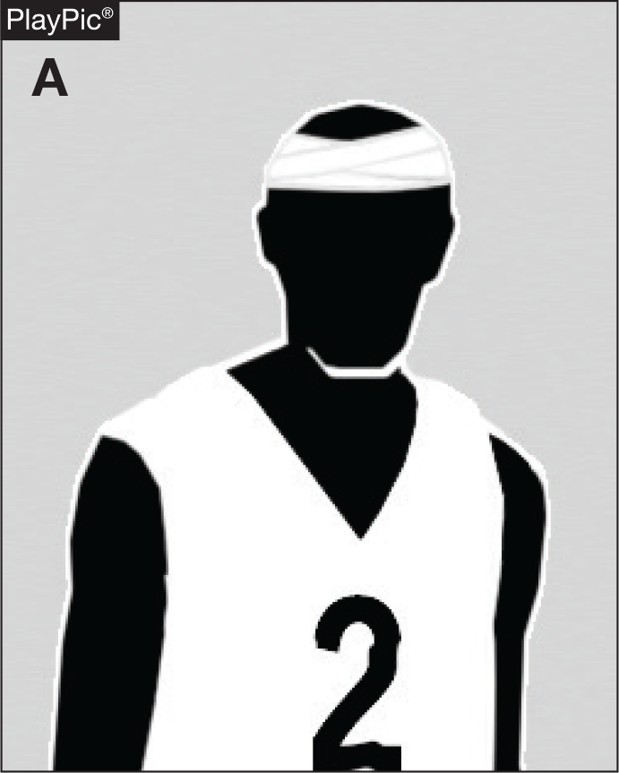
Head Covering Worn for Medical and Religious Reasons
In PlayPic A, the player presents a doctor’s note which indicates the player must wear a head covering for a medical reason, the officials shall permit a non-dangerous covering or wrap to be worn.
Notes:
In PlayPic A, the player presents a doctor’s note which indicates the player must wear a head covering for a medical reason, the officials shall permit a non-dangerous covering or wrap to be worn.

Slide 26
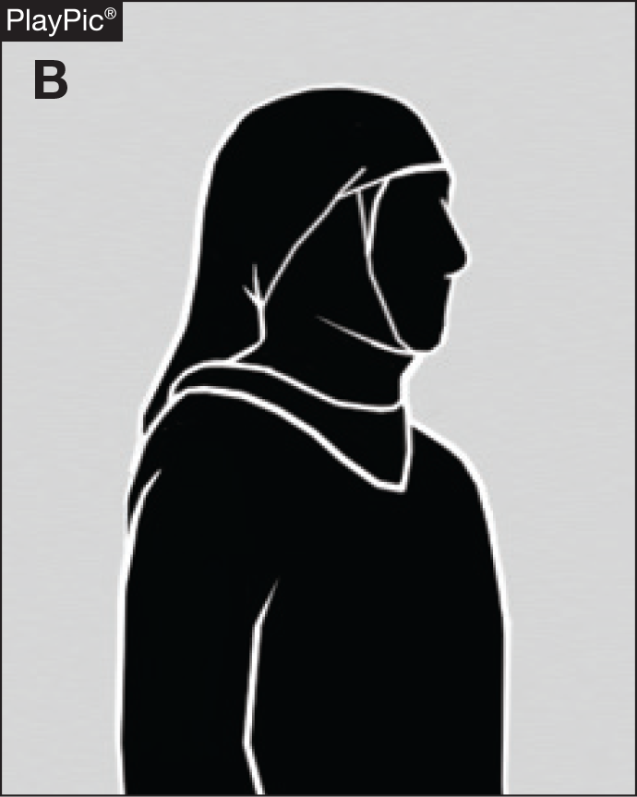
Head Covering Worn for Medical and Religious Reasons
In PlayPic B, the player advises the coach that she/he must wear a head covering for religious reasons, the officials shall permit a non-dangerous covering or wrap to be worn.
The coach and athletic administration must follow the process deemed appropriate by the state.
Notes:
In PlayPic B, the player advises the coach that she/he must wear a head covering for religious reasons, the officials shall permit a non-dangerous covering or wrap to be worn.
The coach and athletic administration must follow the process deemed appropriate by the state.

Slide 27
Team control, throw-in
The relevance of team control during a throw-in only applies when a member of the throw- in team fouls. Such fouls shall be ruled team control fouls. Team control during a throw-in is NOT intended to be the same as player control/team control inbounds. Team control inbounds is established when a player from either team who has inbound status gains control of the ball. During the throw-in, 10-seconds, 3-seconds, frontcourt status, backcourt status, closely guarded, etc., are NOT factors as there has yet to be player control/team control obtained inbounds.
Notes:
Team control, throw-in
The relevance of team control during a throw-in only applies when a member of the throw- in team fouls. Such fouls shall be ruled team control fouls. Team control during a throw-in is NOT intended to be the same as player control/team control inbounds. Team control inbounds is established when a player from either team who has inbound status gains control of the ball. During the throw-in, 10-seconds, 3-seconds, frontcourt status, backcourt status, closely guarded, etc., are NOT factors as there has yet to be player control/team control obtained inbounds.

Slide 28
Team control, throw-in
With specific regard to the backcourt violation; a team may not be the last to touch a live ball in the front court and then be the first to touch a live ball in the backcourt, provided that team has establish player control/team control on the playing court (either in the backcourt or frontcourt). BY RULE EXCEPTION, during a throw-in a team may leave the front court, establish player control/team control while airborne and land in the backcourt. This is a legal play and ONLY applies to the first player of the offense who touches the ball PRIOR to the end of the throw-in.
Notes:
Team control, throw-in
With specific regard to the backcourt violation; a team may not be the last to touch a live ball in the front court and then be the first to touch a live ball in the backcourt, provided that team has establish player control/team control on the playing court (either in the backcourt or frontcourt). BY RULE EXCEPTION, during a throw-in a team may leave the front court, establish player control/team control while airborne and land in the backcourt. This is a legal play and ONLY applies to the first player of the offense who touches the ball PRIOR to the end of the throw-in.

Slide 29
TEAM CONTROl, throw-in
When team A fouls during a throw-in (as shown in MechaniGram A), a team-control foul occurs and no free throws result. When the throw-in ends the throw-in exception ends for the throw-in team to land anywhere on the playing court. In the two-part PlayPic sequence, B2 deflects the throw-in pass and ends the throw-in then A12 establishes player and team control in team A’s frontcourt when catching the ball in the air after last having been in contact with the court in the frontcourt (PlayPic A). Once A12 lands in the backcourt a backcourt violation occurs (PlayPic B).
Notes:
When team A fouls during a throw-in (as shown in MechaniGram A), a team-control foul occurs and no free throws result. When the throw-in ends the throw-in exception ends for the throw-in team to land anywhere on the playing court. In the two-part PlayPic sequence, B2 deflects the throw-in pass and ends the throw-in then A12 establishes player and team control in team A’s frontcourt when catching the ball in the air after last having been in contact with the court in the frontcourt (PlayPic A). Once A12 lands in the backcourt a backcourt violation occurs (PlayPic B).

Slide 30
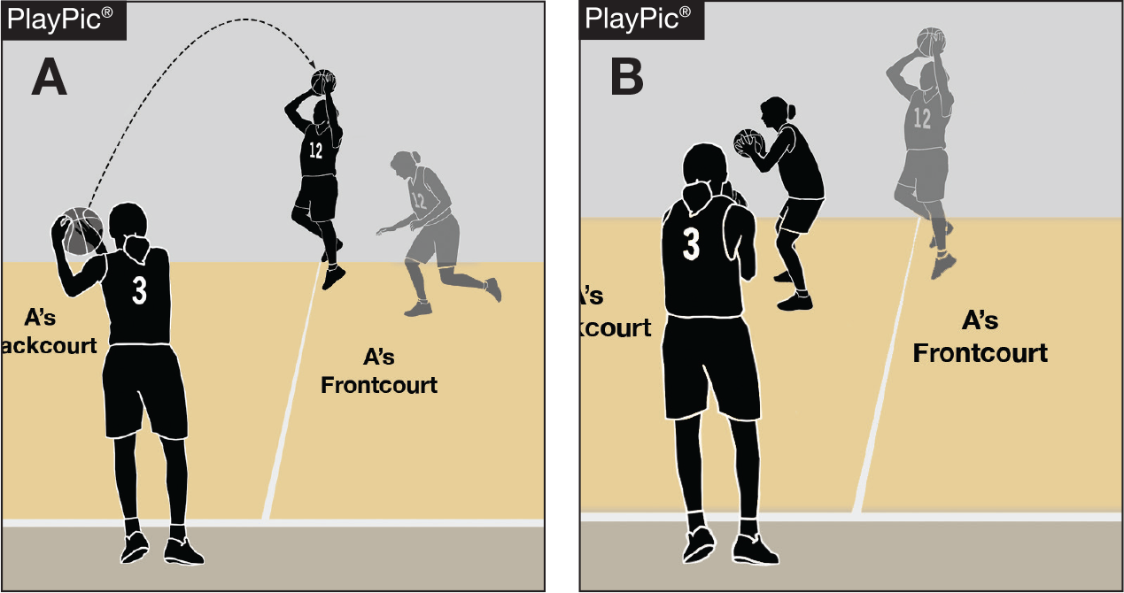
TEAM CONTROl, throw-in
In the two-part sequence, the ball is inbounded directly from a throw-in. Since the throw-in is untouched the throw-in exception for the pass to be caught by a player inbounds (PlayPic A) – even with jumping from the frontcourt – and landing anywhere is in effect. A12’s catch is therefore legal and not a backcourt violation when catching in the backcourt (PlayPic B). A12 could even land with one foot down first in the frontcourt and then one foot in the backcourt, provided it is deemed a normal landing.
Notes:
In the two-part sequence, the ball is inbounded directly from a throw-in. Since the throw-in is untouched the throw-in exception for the pass to be caught by a player inbounds (PlayPic A) – even with jumping from the frontcourt – and landing anywhere is in effect. A12’s catch is therefore legal and not a backcourt violation when catching in the backcourt (PlayPic B). A12 could even land with one foot down first in the frontcourt and then one foot in the backcourt, provided it is deemed a normal landing.

Slide 31
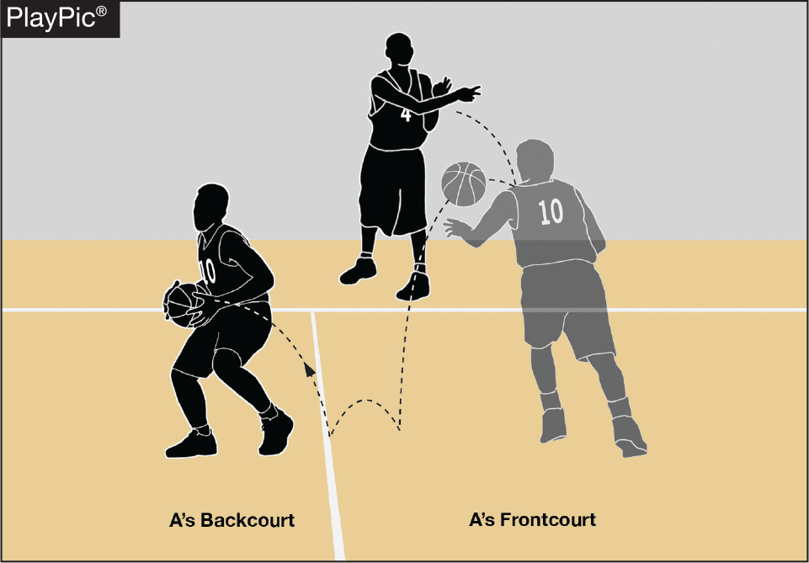
TEAM CONTROl, throw-in
In PlayPic A, A4’s throw-in pass is fumbled by A10. A10’s fumble does not give Team A the required player- and team-control status inbounds in order to have a backcourt violation. Therefore, any Team A player may legally recover the ball if the ball goes into the backcourt.
Notes:
In PlayPic A, A4’s throw-in pass is fumbled by A10. A10’s fumble does not give Team A the required player- and team-control status inbounds in order to have a backcourt violation. Therefore, any Team A player may legally recover the ball if the ball goes into the backcourt.

Slide 32
Intentional Fouls
The committee is concerned about the lack of enforcement for intentional fouls during any part of the game but especially at the end of a game. The intentional foul rule has evolved into misapplication and personal interpretations. An intentional foul is a personal or technical foul that may or may not be premeditated and is not based solely on the severity of the act, it is contact that:
Notes:
Intentional Fouls
The committee is concerned about the lack of enforcement for intentional fouls during any part of the game but especially at the end of a game. The intentional foul rule has evolved into misapplication and personal interpretations. An intentional foul is a personal or technical foul that may or may not be premeditated and is not based solely on the severity of the act, it is contact that:

Slide 33
Intentional Fouls
Neutralizes an opponent’s obvious advantageous position.
Contact on an opponent who is clearly not in the play.
May be excessive contact.
Contact that is not necessarily premeditated or based solely on the severity of the act.
Notes:
Intentional Fouls
Neutralizes an opponent’s obvious advantageous position.
Contact on an opponent who is clearly not in the play.
May be excessive contact.
Contact that is not necessarily premeditated or based solely on the severity of the act.

Slide 34
Intentional Fouls
This type of foul may be strategic to stop the clock or create a situation that may be tactically done for the team taking action. This foul may be innocent in severity, but without any playing of the ball, it becomes an intentional act such as a player wrapping their arms around an opponent. The act may be excessive in its intensity and force of the action. These actions are all intentional fouls and are to be called as such.
Notes:
Intentional Fouls
This type of foul may be strategic to stop the clock or create a situation that may be tactically done for the team taking action. This foul may be innocent in severity, but without any playing of the ball, it becomes an intentional act such as a player wrapping their arms around an opponent. The act may be excessive in its intensity and force of the action. These actions are all intentional fouls and are to be called as such.

Slide 35
Intentional Fouls
Officials must be aware of the game situations as the probability of fouling late in the game is an accepted coaching strategy and is utilized by many coaches in some form. Officials must have the courage to enforce the intentional foul rule properly.
Notes:
Intentional Fouls
Officials must be aware of the game situations as the probability of fouling late in the game is an accepted coaching strategy and is utilized by many coaches in some form. Officials must have the courage to enforce the intentional foul rule properly.

Slide 36
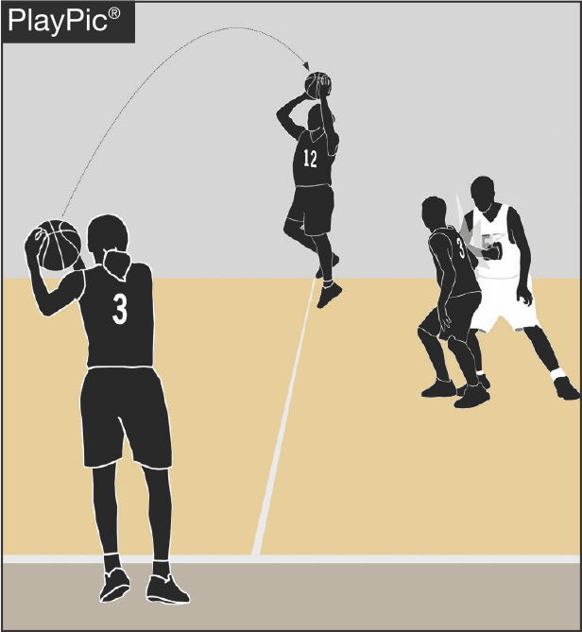
Intentional fouls
Intentional fouls should be ruled at any point in the game when contact neutralizes an opponent’s advantageous position, contact is not a clear attempt to play the ball (as shown in the PlayPic) or when contact is excessive. An intentional foul is not solely judged on the severity of the act.
Notes:
Intentional fouls should be ruled at any point in the game when contact neutralizes an opponent’s advantageous position, contact is not a clear attempt to play the ball (as shown in the PlayPic) or when contact is excessive. An intentional foul is not solely judged on the severity of the act.

Slide 37
Guarding
The addition of rule 10.7.12, has been successful in its intent to clean up illegal contact on the ballhandler/dribbler and post players. Players are attempting to replace this illegal contact with contact observed as “body bumping”. Illegal contact with the body must be ruled a foul however, officials must accurately identify if the defense or offense causes the contact and penalize the player causing the illegal contact.
Notes:
Guarding
The addition of rule 10.7.12, has been successful in its intent to clean up illegal contact on the ballhandler/dribbler and post players. Players are attempting to replace this illegal contact with contact observed as “body bumping”. Illegal contact with the body must be ruled a foul however, officials must accurately identify if the defense or offense causes the contact and penalize the player causing the illegal contact.

Slide 38
Guarding
Once a defensive player obtains legal guarding position by facing an opponent with both feet of the floor inbounds, he/she may move to maintain that position in any direction except toward the offensive player being guarded when contact occurs. The defense is not required to keep both feet on the playing court and may jump vertically or laterally to maintain the legal position. If contact occurs prior to the offensive player getting head and shoulders passed the defender the responsibility is on the offensive player.
Notes:
Guarding
Once a defensive player obtains legal guarding position by facing an opponent with both feet of the floor inbounds, he/she may move to maintain that position in any direction except toward the offensive player being guarded when contact occurs. The defense is not required to keep both feet on the playing court and may jump vertically or laterally to maintain the legal position. If contact occurs prior to the offensive player getting head and shoulders passed the defender the responsibility is on the offensive player.

Slide 39
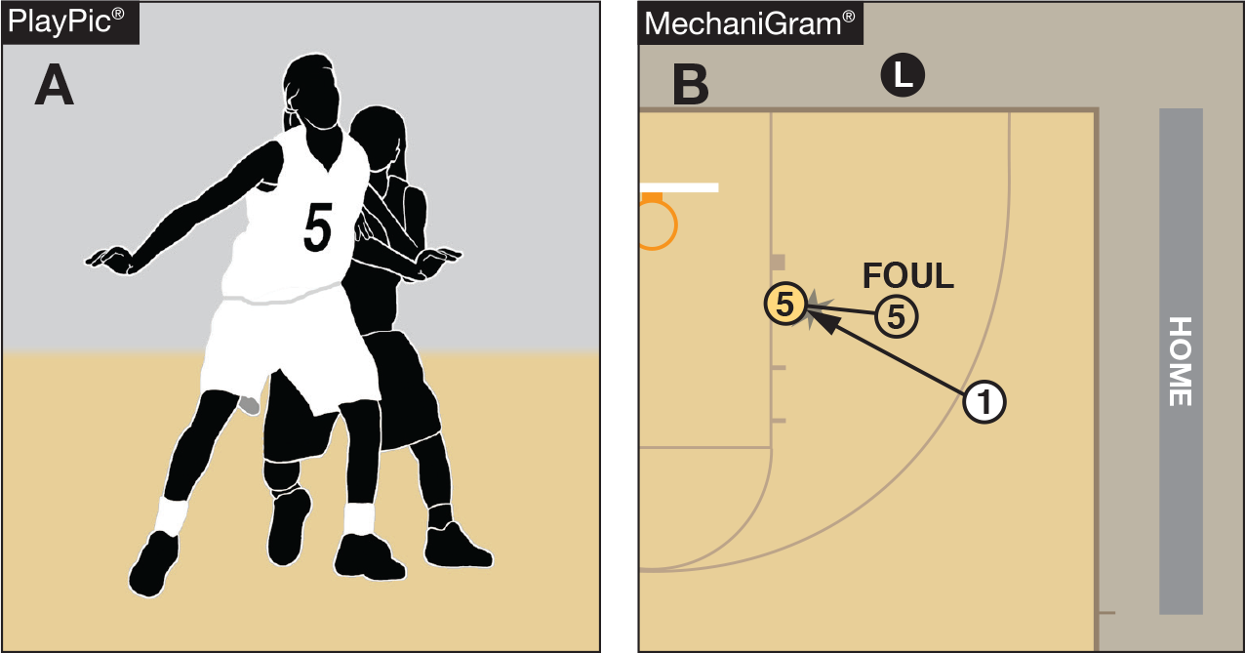
guarding
A player may not displace an opponent with any body part, including the lower body/legs (as shown in PlayPic A). In order to gain legal guarding position a player must have two feet down on the court and be facing their opponent. Once a legal guarding position is obtained the defender can maintain that position legally by moving in any direction (backward or laterally) as long as they do not initiate contact into the opponent (as shown in MechaniGram B).
Notes:
Guarding
A player may not displace an opponent with any body part, including the lower body/legs (as shown in PlayPic A). In order to gain legal guarding position a player must have two feet down on the court and be facing their opponent. Once a legal guarding position is obtained the defender can maintain that position legally by moving in any direction (backward or laterally) as long as they do not initiate contact into the opponent (as shown in MechaniGram B).

Slide 40
PIAA Exceptions to NFHS:
A. Uniform*:
1. Shirt - Alternating black and white 1-inch vertically striped, short- sleeved shirt A PIAA patch must be worn on the left shoulder. Wide panel shirts are not permitted.
2. Slacks - Black full length trousers.
3. Belt – Black (if worn).
4. Socks - Black.
5. Shoes - Solid black with black laces.
6. Lanyard - Black.
7. Whistle – Black (Pink whistle, single game only “awareness” contest, no other pink items permitted, not for a month, etc.)
*All approved uniforms are listed in the officials’ manual at www.piaa.org

Slide 41
PIAA Exceptions to NFHS:
B. Disqualification:
Any Coach and/or contestant ejected for unsportsmanlike conduct or flagrant misconduct is disqualified for the remainder of the day and in all Contests on the next Contest day of the same level (varsity, junior varsity, or otherwise). For a Coach, participation in the next Contest includes any contact by the Coach with members of the Team, including other Coaches, between the time that the Team arrives at the Contest site and the conclusion of the last Contest of the day. The Principal must direct the Coach not to attend all of the Contest(s).

Slide 42
B. Disqualification cont.
Any Coach and/or contestant ejected from the last Contest(s) in that sport in a sport season is disqualified from Coaching and/or participating in the first Contest(s) in that sport in the subsequent sport season, at the same level (varsity, junior varsity, or otherwise) of competition, at any PIAA member school or, if the Coach and/or student changes levels of competition, such as from junior varsity to varsity, the first Contest(s) in that sport.

Slide 43
Disqualification cont.
The official must file a report with the PIAA Office within 24 hours of the contest.
In Basketball, the athletic director and principal must meet with the ejected coach/contestant and detail in a report what corrective action has been taken. This report then must be signed by all parties and sent to the district Basketball chairperson.

Slide 44
PIAA Exceptions to NFHS:
Sportsmanship:
1. It is mandatory that both head coaches attend the pre- game meeting with the captains and officials.
2. PIAA requires all registered sports’ officials to enforce the sportsmanship rule for the coaches and contestants. The statement is located on the back of the official identification card as well as the Pre-Season Basketball Bulletin and must be read to the head coaches and captains at the pregame meeting.

Slide 45
SPECIAL NOTE ON SPORTMANSHIP
**This message shall be read to the head coach and captains prior to each contest officiated by a registered PIAA official. This message shall be enforced by contest officials and its enforcement shall include a strict and swift enforcement when unsportsmanlike actions involve demeaning remarks or actions that may be related to the racial or ethnic background of any party.**
PIAA requires all registered sports' officials to enforce the sportsmanship rules for coaches and contestants. Actions meant to demean opposing contestants, team, spectators, and officials are not in the highest ideals of interscholastic education and will not be tolerated. Let today's contest reflect mutual respect. Coaches please certify to the officials that your players are legally equipped and uniformed according to NFHS rules and PIAA adoptions. Good luck in today's contest..

Slide 46
Television Monitor Review/Media Timeouts
May use television/replays for post-regular season tournament (PIAA Championship) for determining two or three-point goal or if try is released prior to expiration of time
Media Timeouts may be used in Inter-district play. Playoff officials should review media timeout procedures in pregame. This is available at www.piaa.org/rules

Slide 47
Adopt Rules 1-13-2 and 1-13-2 NOTE, Coaching box and alternate placement of same, at all levels (varsity, junior varsity, or otherwise) of competition
Adopt Rule 10-5-1, the head coach, at all levels (varsity, junior varsity, or otherwise) of competition, may be off the bench in front of his/her seat within the confines of the designated 28-foot coaching box to give instructions to his/her players and/or substitutes
Fall season note: Fall basketball leagues are to play under the previous seasons’ rules. Rule changes take effect on the official winter start date and may begin with pre-season scrimmages.

Slide 48
3-3-8… Any player who exhibits signs, symptoms or behaviors consistent with a concussion (such as loss of consciousness, headache, dizziness, confusion, or balance problems) shall be immediately removed from the game and shall not return until cleared by an appropriate health care professional.
PIAA Modified Rule 3-3-8 (Concussion Rule), to clarify that “an appropriate health-care professional” is a licensed physician of medicine or osteopathic medicine (MD or DO).

Slide 49
Adopt Rule 5-5 NOTE, running clock, at all levels (varsity, junior varsity, or otherwise) of competition, upon completion of the first half and one Team gains a 40-point differential over its opponent, the clock shall be stopped only when an official's time-out is taken, a charged time-out is granted, a period ends, or administering free throws.

Slide 50
PUBLIC ADDRESS PROTOCOL
The public address announcer is considered a bench official for all PIAA District and Inter-District Contests. He/she shall maintain complete neutrality at all times and, as such, shall not be a “cheerleader” for any Team. The announcer will follow the PIAA script for promotional announcements, player introduction and awards ceremonies. These scripts may be obtained from PIAA headquarters.

Slide 51
PUBLIC ADDRESS PROTOCOL
Other announcements are limited to:
● Those of an emergency nature (e.g., paging a doctor, lost child or parent, etc.);
● Those of a “practical” nature (e.g., announcing that a driver has left his/her vehicle lights on);
● Starting lineups or entire lineups of both participating Teams (what is announced for the home Team must be announced for the visiting Team); and
● Announcements that the PIAA souvenir merchandise, souvenir programs and concessions are on sale in the facility.

Slide 52
PUBLIC ADDRESS PROTOCOL
During the Contest, the announcer should:
● Recognize players about to attempt a play (e.g., coming up to bat in baseball, punting, kicking or receiving a kick or punt in football, serving in volleyball, etc.);
● Recognize a player for making a play (e.g., “basket by Jones” in basketball, “Smith on the kill” in volleyball);
● Report a penalty as signaled by the referee/official;
● Report substitutions and time-outs;

Slide 53
PUBLIC ADDRESS PROTOCOL
During the Contest, the announcer should:
● NOT call the “play-by-play” or provide “color commentary” as if he/she were announcing for a radio or television broadcast;
● NOT make any comment that would offer either Team an unfair advantage in the Contest; and
● NOT make any comments critical of any school, Team, player, Coach or official, nor make any other comment that has the potential to incite unsporting conduct on the part of any individual.
The announcer should be certain of the accuracy of his/her statements before making them. When in doubt, the announcer should remain silent.

Slide 54
OTHER BASKETBALL INFORMATION
2017-18
Notes:
About the NFHS learning center

Slide 55
Mid-Season Webinar
During the Basketball round table held during the summer meeting, Basketball Liaisons indicated the need to move the mid-season webinar until after the winter holidays.
Thursday, January 18, 2018 at 2:00 p.m., EST
Notes:
In Developmental Stage
Sport-specific - Basketball
Other Sport-Specific Courses to Follow

Slide 56
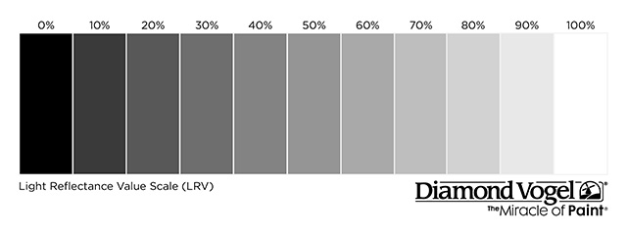
Visiting Team Jerseys Gray Color Spectrum chart
100% 90% 80% 70% 60% 50% 40% 30% 20% 10% 0%
Notes:
Comment on Slide:
The NFHS has decided that beginning in 2021 in Basketball, for the color gray and/or any other light colors being used for an away jersey, it cannot go below 70% shading of the main color being used in order for it to clearly contrast with white.

Slide 57
QUESTIONS?
Notes:
QUESTIONS

Slide 58
Rule Change Review
1-13-2 NEW
The coaching box shall be outlined outside the court on which the scorer’s and timer’s table and team benches are located. The area shall be bounded by a line drawn 28 feet from the end line toward the division line.

Slide 59
Rule Change Review
2-9-1
The official shall verbally inform the offender, then with the finger(s) of two hands, indicate to the scorer the number of the offender and the number of the free throws.

Slide 60
Rule Change Review
3-4-1d and 3-4-4
There are restrictions on what identifying names may be placed in this area.

Slide 61
Rule Change Review
4-48
Official warning given for misconduct to coaches or bench personnel and is to be recorded in the scorebook.

Slide 62
Editorial Change Review
4-4-7b
A ball is at the disposal of the thrower or free thrower after it is bounced to him/her.

Slide 63
Editorial Change Review
PIAA Adoption
Specific protocols for announcers adopted.

Slide 64
THANK YOU and HAVE A GREAT SEASON!

